Slide 1
1:1-11

Slide 2
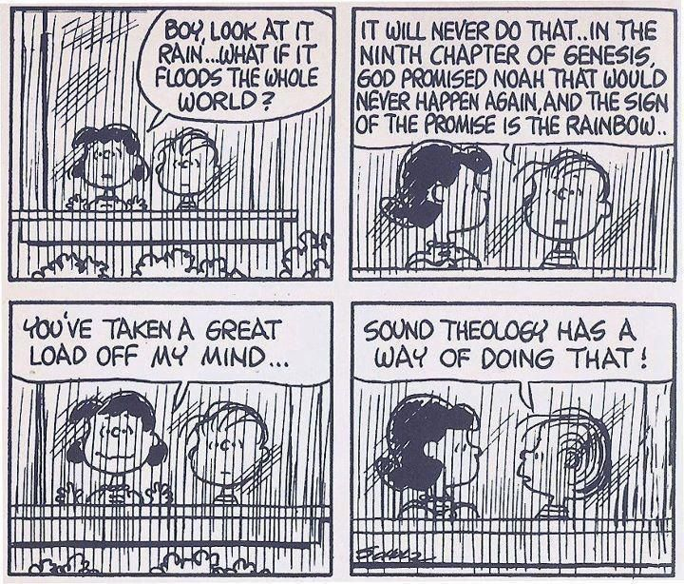
1:1-11

Slide 3
1:1-11

Slide 4
1:1-11
https://www.youtube.com/watch?v=A8zWWp0akUU&t=31s

Slide 5
1:1-11
2 Pet. 1:20-21a (NLT) ~ ²⁰ Above all, you must realize that no prophecy in Scripture ever came from the prophet’s own understanding, ^{21a} or from human initiative.

Slide 6
1:1-11
1 Timothy 1:1–11 ~ ¹ Paul, an apostle of Jesus Christ, by the commandment of God our Savior and the Lord Jesus Christ, our hope,
² To Timothy, a true son in the faith:
Grace, mercy, and peace from God our Father and Jesus Christ our Lord.
³ As I urged you when I went into Macedonia – remain in Ephesus that you may charge some that they teach no other doctrine, ⁴ nor give heed to fables and endless genealogies, which cause disputes rather than godly edification which is in faith.

Slide 7
1:1-11
1 Timothy 1:1–11 ~ ⁵ Now the purpose of the commandment is love from a pure heart, from a good conscience, and from sincere faith, ⁶ from which some, having strayed, have turned aside to idle talk, ⁷ desiring to be teachers of the law, understanding neither what they say nor the things which they affirm.
⁸ But we know that the law is good if one uses it lawfully, ⁹ knowing this: that the law is not made for a righteous person, but for the lawless and insubordinate, for the ungodly and for sinners,

Slide 8
1:1-11
1 Timothy 1:1–11 ~ for the unholy and profane, for murderers of fathers and murderers of mothers, for manslayers, ¹⁰ for fornicators, for sodomites, for kidnappers, for liars, for perjurers, and if there is any other thing that is contrary to sound doctrine, ¹¹ according to the glorious gospel of the blessed God which was committed to my trust.

Slide 9
1:1-11

Slide 10
1:1-11
Paul writes
Philemon
Paul writes
1 Timothy
Paul writes
Titus
Paul writes
2 Timothy
Paul’s martyrdom
AD 61
AD 62
AD 63
AD 64
AD 65
AD 66
AD 67
Paul’s 1st imprisonment
Paul’s 2nd imprisonment

Slide 11
1:1-11

Slide 12
1:1-11
Is. 43:11 ~ I, even I, am the Lord, and besides Me there is no savior.
NWT ~ I – I am Jehovah, and besides me there is no savior.
Is. 45:21 ~ And there is no other God besides Me, a just God and a Savior; there is none besides Me.
NWT ~ There is no other God but me; A righteous God and a Savior, there is none besides me.
At least 10x in Old Testament

Slide 13
1:1-11
There is one God
There is one Savior
YAHWEH
JESUS
Act 4:12 ~ Nor is there salvation in any other, for there is no other name (i.e. Jesus) under heaven given among men by which we must be saved.
NWT ~ Furthermore, there is no salvation in anyone else, for there is no other name (i.e. Jesus) under heaven that has been given among men by which we must get saved.”

Slide 14
1:1-11

Slide 15
1:1-11
Timothy ~ timotheos – honored of God
Romans
1&2 Corinthians
Galatians
Ephesians
Grace
mercy
1&2 Timothy
to you
Philippians
Titus
and peace
Colossians
1&2 Thessalonians
Philemon

Slide 16
1:1-11

Slide 17
1:1-11
doctrine ~ didaskalos (noun); didaskalia (verb)
doctrine, teaching, teach, teacher, etc.
At least 30x in the Pastoral Epistles
“Christianity just has so many different religions”
Walter Martin (1928-1989) ~ “Controversy for the sake of controversy is a sin. But controversy for the sake of truth is a divine command.”

Slide 18
1:1-11
Calvinism
Pre-Tribulationism
Cessationism
Arminianism
Continuationism
Preterism
METRONOME
OF
CHRISTIANITY

Slide 19
1:1-11

Slide 20
1:1-11
Sharing an opinion
in America

Slide 21
1:1-11

Slide 22
1:1-11
Does the teaching agree with the 3 inarguables from Scripture?
1. Christ’s Work
Gal. 1:8 ~ But even if we, or an angel from heaven, preach any other gospel to you than what we have preached to you , let him be accursed.
Gal. 3:3 ~ Are you so foolish? Having begun in the Spirit, are you now being made perfect by the flesh?

Slide 23
1:1-11
Does the teaching agree with the 3 inarguables from Scripture?
2. Christ’s Person
1 John 4:2-3 ~ ² By this you know the Spirit of God: Every spirit that confesses that Jesus Christ has come in the flesh is of God, ³ and every spirit that does not confess that Jesus Christ has come in the flesh is not of God. And this is the spirit of the Antichrist, which you have heard was coming, and is now already in the world.

Slide 24
1:1-11
Does the teaching agree with the 3 inarguables from Scripture?
3. Christ’s Resurrection
1 Cor. 15:14-17 ~ ¹⁴ And if Christ is not risen, then our preaching is empty and your faith is also empty. ¹⁵ Yes, and we are found false witnesses of God, because we have testified of God that He raised up Christ, whom He did not raise up—if in fact the dead do not rise. ¹⁶ For if the dead do not rise, then Christ is not risen. ¹⁷ And if Christ is not risen, your faith is futile; you are still in your sins!

Slide 25
1:1-11
Does the teaching agree with the 3 inarguables from Scripture?
2. Christ’s Person (who He is)
1. Christ’s Work (what He did)
3. Christ’s Resurrection (demonstration of His victory)

Slide 26
1:1-11

Slide 27
1:1-11
Does the teaching lead to Christlikeness?
Phil. 2:5-8 ~ ⁵ Let this mind be in you which was also in Christ Jesus, ⁶ who, being in the form of God, did not consider it robbery to be equal with God, ⁷ but made Himself of no reputation, taking the form of a bondservant, and coming in the likeness of men. ⁸ And being found in appearance as a man, He humbled Himself and became obedient to the point of death, even the death of the cross.

Slide 28
1:1-11
Does the teaching lead to true worship of the true God?
1 Cor. 14: 40 ~ Let all things be done decently and in order.
John 4:23-24 ~ ²³ But the hour is coming, and now is, when the true worshipers will worship the Father in spirit and truth; for the Father is seeking such to worship Him. ²⁴ God is Spirit, and those who worship Him must worship in spirit and truth.

Slide 29
1:1-11
things I disagree with
aberrant beliefs
truth
error
What I believe
Heresy
truth-o-meter

Slide 30
1:1-11

Slide 31
1:1-11
fables ~ muthos (myth) – Jewish allegory or rudimentary Gnosticism

Slide 32
1:1-11

Slide 33
1:1-11
Soren Kierkegaard ~ “Purity of heart is to will one thing”

Slide 34
1:1-11

